Slide 1
UNIT 4
Knowledge Representation

Slide 2
Syllabus
KNOWLEDGE REPRESENTATION
First order logic – representation revisited – Syntax and semantics for first order logic – Using first order logic – Knowledge engineering in first order logic - Inference in First order logic – propositional versus first order logic – unification and lifting – forward chaining – backward chaining - Resolution - Knowledge representation - Ontological Engineering - Categories and objects.

Slide 3
Knowledge Base
An intelligent agent needs knowledge about the real world for taking decisions and reasoning to act efficiently.
Knowledge base consist of sentences.
These sentences are expressed using
Syntax
Semantics

Slide 4
Knowledge Base
Syntax - Specify the sentences that are well formed.
Example: x+y=4
x4y+=
Semantics – Define the meaning of the sentence. It specifies the truth of each sentence
Example: x+y=4 is true if x=2 and y=2
Model is used in place of possible world. It is a mathematical abstraction, which simply fixes the truth or falsehood of every relevant sentence.

Slide 5
Logic
It is the proof of validation behind any reason provided.
Propositional Logic (PL)
First Order Logic (FOL)

Slide 6
Proposition Logic (PL)
It is the simplest form of logic.
All the statements are made by propositions.
A proposition is a declarative statement which is either true or false.
Symbolic variables such as A, B, C, P, Q, R, etc. can be used to represent the logic.
Propositions can be either true or false, but it cannot be both.
Example:
5 is a prime number
3+4= 8

Slide 7
Propositional Logic - Syntax
The syntax of propositional logic defines the allowable sentences.
There are two types of Sentences (Propositions):
Atomic Propositions or Atomic Sentences
Compound propositions or Compound Sentences

Slide 8
Propositional Logic - Syntax
Atomic Sentences:
Atomic propositions are the simple propositions.
It consists of a single proposition symbol.
Example: 2+2 = 4 - True
The sun is cold - False

Slide 9
Propositional Logic - Syntax
Compound Sentences:
Constructed by combining simpler or atomic propositions, using parentheses and logical connectives.
Example - "It is raining today, and street is wet."
"Ankit is a doctor, and his clinic is in Mumbai."

Slide 10
Propositional Logic - Syntax
Compound Sentences:
There are five connectives
Negation (~) - NOT
Conjunction (∧) - AND
Disjunction (V) - OR
Implication (🡪) - IMPLIES
Biconditional (⬄) - IF AND ONLY IF

Slide 11
Propositional Logic - Semantics
It defines the rules for determining the truth of a sentence with respect to a particular model.
It specifies how to compute the truth of atomic sentences formed with five connectives.
Atomic Sentences - True is true in every model and False is false.
Complex Sentences - Five Rules
~P is true iff P is false
P∧Q is true iff P and Q are true
PVQ is true iff either P or Q is true

Slide 12
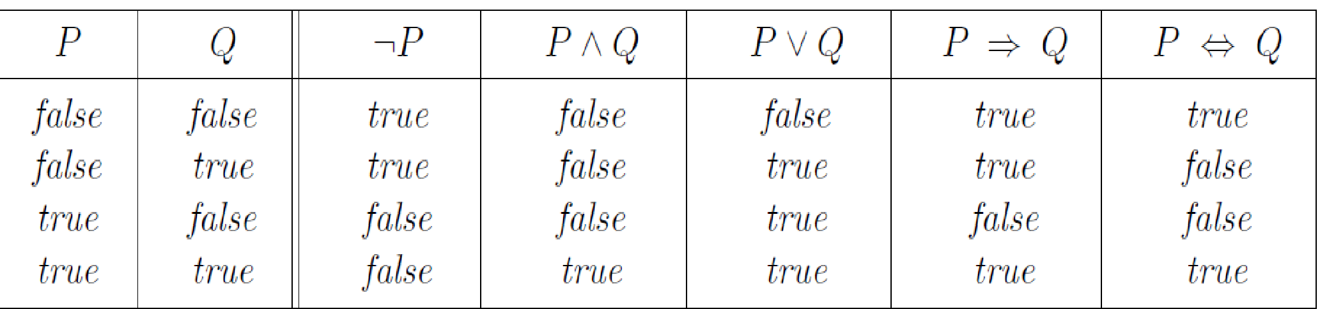
Propositional Logic - Semantics
P🡪Q is true iff unless P is true and Q is false
P⬄Q is true iff P and Q are both true or false
Truth Table - The rules can also be expressed with truth tables.
A proposition formula which is always true is called Tautology.
A proposition formula which is always false is called Contradiction.

Slide 13
Propositional Logic - Drawbacks
ALL, some, or none with propositional logic.
Example: All the girls are intelligent.
Some apples are sweet.
It has limited expressive power.
Statements cannot be described in terms of their properties or logical relationships.
In propositional logic, we can only represent the facts, which are either true or false.

Slide 14
First Order Logic (FOL)
First-order logic is another way of knowledge representation in artificial intelligence.
It is an extension to propositional logic.
It is sufficiently expressive to represent the natural language statements in a concise way.
First-order logic is also known as Predicate logic or First-order predicate logic.

Slide 15
First Order Logic
It is much more expensive than PL.
It is built around objects and relations.
Objects (noun or noun phrases) : A, B, people, numbers etc. [Subject]
Relations (verb and verb phrases): It can be unary relation or properties such as: red, round, prime, or n-any relation such as: the sister of, brother of, part of etc. [Predicate]
Function (return object for the given relation): Father of, best friend of, etc.

Slide 16
Difference between PL and FOL
Language | Ontological Commitment (What exists in the world) | Epistemological Commitment (What an agent believe about facts)
PL | Facts | true/false/unknown
FOL | Facts, objects, relations | true/false/unknown

Slide 17
Syntax and Semantics of FOL
Model - Models of FOL have objects.
The domain of a model is the set of objects and it should not be empty
A tuple is a collection of objects arranged in a fixed order.

Slide 18
Syntax and Semantics of FOL - Symbols and Interpretation
Symbols - Names begin with uppercase letters
Constant symbols - objects
Ex: Richard, John
Predicate symbols - Relations
Ex: Brother , OnHead, Person, King, Crown
Function symbols - Functions
Ex: Father of, Brother of

Slide 19
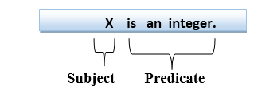
Statements in FOL
FOL statements can be divided into 2 Parts:
Subject - Subject is the main part of the statement
Predicate - A predicate can be defined as a relation, which binds two objects together in a statement.
Example: "x is an integer.", it consists of two parts, the first part x is the subject of the statement and second part "is an integer," is known as a predicate.

Slide 20
Atomic Sentences
It is the most basic sentence of first-order logic.
These sentences are formed from a predicate symbol followed by a parenthesis with a sequence of terms.
Predicate (term1, term2, ......, term n).
Examples:
“Ravi and Ajay are brothers” can be represented in FOL as
Brothers(Ravi, Ajay)
2. “Jack is a dog” can be represented in FOL as
Dog(Jack)

Slide 21
Compound Sentences
Complex sentences are made by combining atomic sentences using connectives.
Example: Brother (Richard,John) ∧ Brother (John,Richard)

Slide 22
Quantifiers in FOL
It is used to express the properties of entire collection of objects.
It specifies the quantity of specimen in the universe of disclosure.
There are two types of quantifier:
Universal Quantifier (for all, everyone, everything)
Existential quantifier (for some, at least one).

Slide 23
Universal Quantifier (∀)
It specifies that the statement within its range is true for everything or every instance of a particular thing.
The Universal quantifier is represented by a symbol ∀.
In universal quantifier we use implication "→".
∀x is read as: For all x OR For each x OR For every x.

Slide 24
Universal Quantifier (∀)
Example: All man drink coffee
Let x be a variable which refers to man, the representation of the above sentence in FOL is as shown below:
∀x man(x) → drink(x, coffee)
It will be read as: For all x where x is a man who drinks coffee.
All Kings are Persons
Let x be a variable which refers to King, the representation of the above sentence in FOL is as shown below:
∀x King(x) → Person(x)
It will be read as: For all x, if x is a King then x is a person.

Slide 25
Existential Quantifier (∃)
It express that the statement within its scope is true for at least one instance of something.
It is denoted by the logical operator ∃.
In Existential quantifier we always use AND or Conjunction symbol (Ʌ).
∃x or ∃(x) will be read as: There exists a 'x’ OR For some 'x’ OR For at least one ‘x’.
Example: Some boys are intelligent
∃x: boys(x) ∧ intelligent(x)
It will be read as: There are some x, where x is a boy who is intelligent

Slide 26
Nested Quantifiers
Compound sentences can be expressed using multiple quantifiers.
Properties of Quantifiers
In universal quantifier, ∀x∀y is similar to ∀y∀x.
In Existential quantifier, ∃x∃y is similar to ∃y∃x.
∃x∀y is not similar to ∀y∃x.

Slide 27
Connections between ∀ and ∃
∀ and ∃ are connected through negation.
Example:
Everyone likes ice cream
∀ x Likes(x, IceCream)
There does not exist someone who dislikes them
¬∃ x ¬Likes(x, IceCream)
∀ x Likes(x, IceCream) is equivalent to ¬∃ x ¬Likes(x, IceCream)

Slide 28
Connections between ∀ and ∃
Example:
Everyone dislikes Junks
∀ x ¬Likes(x, Junks )
There does not exist someone who likes them
¬∃ x Likes(x, Junks)
∀ x ¬Likes(x, Junks ) is equivalent to ¬∃ x Likes(x, Junks)

Slide 29
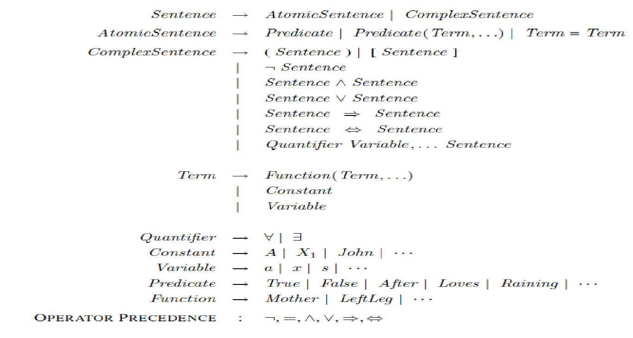
Syntax of FOL

Slide 30
Examples
Convert the following sentences into well-formed formulas (Wff’s)
All birds fly
∀x bird(x) → fly(x)

Slide 31
Examples Of FOL
Every man respects his parent
∀x man(x) → respects(x, Parent)

Slide 32
Examples Of FOL
Every Gardener likes the Sun
∀x Gardener(x) → likes(x, Sun)

Slide 33
Examples Of FOL
Denny is not tall
~tall(Denny)

Slide 34
Examples Of FOL
All Pompeians are Romans
∀x Pompeians(x) → Romans(x)

Slide 35
Examples Of FOL
Picasso was a Painter
Painter(Picasso)

Slide 36
Examples Of FOL
Every Elephant is Grey
∀x Elephant(x) → Grey(x)

Slide 37
Examples Of FOL
Fenny is a Professor
Professor(Fenny)

Slide 38
Examples Of FOL
Lucy criticize John
Criticize(Lucy,John)

Slide 39
Examples Of FOL
Some boys play cricket
∃x boys(x) Ʌ play (x, Cricket)

Slide 40
Examples Of FOL
There exists a White Alligator
∃x Alligator(x) Ʌ White (x)

Slide 41
Examples Of FOL
There exists some bird that doesn’t fly
∃x bird(x) Ʌ ~fly (x)

Slide 42
Examples Of FOL
Not all students like both Mathematics and Science
~∀x [student (x) → like(x, Mathematics) Ʌ like(x, Science) ]

Slide 43
Examples Of FOL
Lipton is a Tea
Tea (Lipton)

Slide 44
Examples Of FOL
Every man is mortal
∀x man(x) → mortal(x)

Slide 45
Examples Of FOL
All girls are beautiful
∀x girls(x) → beautiful(x)

Slide 46
Examples Of FOL
All that glitters are not gold
∀x glitters(x) → ~gold(x)

Slide 47
Examples Of FOL
Some boys are obedient
∃x boys(x) Ʌ obedient(x)

Slide 48
Examples Of FOL
Some cows are black and some cows are white
∃x cows(x) Ʌ black(x) Ʌ white(x)

Slide 49
Examples Of FOL
Everyone likes Ice cream
∀x likes(x, Ice Cream)

Slide 50
Examples Of FOL
Brothers are siblings
∀x ∀y Brothers(x, y) → Siblings(x, y)

Slide 51
Examples Of FOL
Everybody loves somebody
∀x ∃y Loves(x, y)

Slide 52
Examples Of FOL
There is someone who is loved by everyone
∃y ∀x Loves(x, y)

Slide 53
Examples Of FOL
King John has a crown on his head
∃x Crown(x) Ʌ Onhead(x, John)

Slide 54
Examples Of FOL
Everyone dislikes parsnips
∀x ~Likes(x, Parsnips) or ~∃x Likes(x, Parsnips)
None of my friends are perfect
∀x F(x) → ~P(x) or ~ ∃x F(x) Ʌ P(x)
Every house is a physical object
∀x (house(x) → physical object(x))
Some physical objects are houses
∃x (physical object(x) ∧ house(x))
Every house has an owner
∀x(house(x) → ∃y.owns(y, x)),

Slide 55
Examples Of FOL
Everybody owns a house
∀x ∃y (owns(x, y) ∧ house(y))
Sue owns a house
∃x (owns(Sue, x) ∧ house(x))
Somebody does not own a house
∃x ∀y (owns(x, y) → ¬house(y))
All Kings who are Greedy are Evil
∀x King(x) ∧ Greedy (x) → Evil(x)

Slide 56
Examples of FOL
John likes all kind of food.
∀x: food(x) → likes(john, x)
Apple and vegetable are food
Food(Apple) ∧ Food(Vegetable)
Anything anyone eats and not killed is food.
∀x ∀y eats(x,y) ∧ ¬Killed(x)→Food(y)
Anil eats peanuts and still alive
eats(Anil,peanuts)∧Alive(Anil)
Harry eats everything that Anil eats.
∀x: eats(Anil,x)→eats(Harry,x)
John likes peanuts Likes(John,Peanuts)

Slide 57
Syllabus
KNOWLEDGE REPRESENTATION
First order logic – representation revisited – Syntax and semantics for first order logic – Using first order logic – Knowledge engineering in first order logic - Inference in First order logic – propositional versus first order logic – unification and lifting – forward chaining – backward chaining - Resolution - Knowledge representation - Ontological Engineering - Categories and objects

Slide 58
Knowledge Engineering in FOL
The process of constructing a knowledge-base in first-order logic is called as knowledge- engineering.
Knowledge engineer investigates a specific domain, learn the important concepts regarding that domain, and creates the formal representation of the objects and relations in that domain.

Slide 59
Knowledge Engineering in FOL - Steps
Identify the tasks
Assemble the relevant Knowledge
Decide on Vocabulary
Encode general Knowledge about the domain
Encode a description of the problem instance
Pose queries to the inference procedure and get answers
Debug the knowledge base

Slide 60
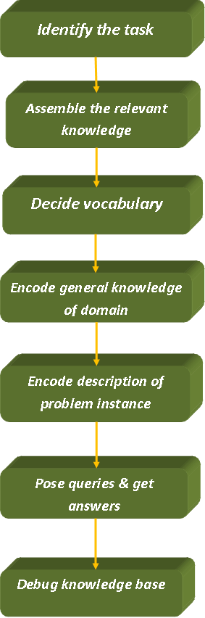

Slide 61
Knowledge Engineering Process
Identify the task:
A knowledge engineer should be able to identify the task by asking a few questions like:
Do the knowledge base will support?
What kinds of facts will be available for each specific problem?
The task will identify the knowledge requirement needed to connect the problem instance with the answers.

Slide 62
Knowledge Engineering Process
Assemble the relevant knowledge:
A knowledge engineer should be an expert in the domain.
If not, he should work with the real experts to extract their knowledge.
This concept is known as Knowledge Acquisition.

Slide 63
Knowledge Engineering Process
Decide on a vocabulary of constants, predicates, and functions:
Translating important domain-level concepts into logical level concepts.
Here, the knowledge engineer asks questions like:
What are the elements which should be represented as objects?
What functions should be chosen?
After satisfying all the choices, the vocabulary is decided.
It is known as the Ontology of the domain.
Ontology determines the type of things that exists but does not determine their specific properties and interrelationships.

Slide 64
Knowledge Engineering Process
Encode general knowledge about the domain:
In this step, the knowledge engineer pen down the axioms/rules for all the chosen vocabulary terms.
Encode description of the specific problem instance:
We write the simple atomic sentences for the selected vocabulary terms.
We encode the chosen problem instances.

Slide 65
Knowledge Engineering Process
Raise queries to the inference procedure and get answers:
It is the testing step.
We apply the inference procedure on those axioms and problem-specific facts which we want to know.
Debug the knowledge base:
It is the last step of the knowledge engineering process where the knowledge engineer debugs all the errors.

Slide 66
Inferences in FOL
Inferences in FOL is used to create new facts or sentences from the existing sentences.
Inference rules for Quantifiers:
Universal Instantiation (Substitution)
Existential Instantiation

Slide 67

Inferences in FOL
Universal Instantiation:
Any sentence can be inferred by substituting a ground term for the variable
Ground Term - Term without variable
Rule - Let denote the result of applying the substitutions θ to sentence α

Slide 68

Inferences in FOL
Universal Instantiation: Example
All Greedy Kings are Evil
From the above statement we can infer the following:
{x/John}
{x/Richard}

Slide 69

Inferences in FOL
Existential Instantiation:
Variable is replaced by a single new constant symbol
Rule - For any sentence α, variable v and constant symbol k (that does not appear elsewhere in the knowledge base)
The new constant symbol used is known as Skolem Constant.
Existential Instantiation is also known as Skolemization.

Slide 70
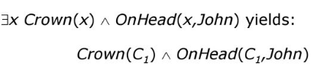
Inferences in FOL
Existential Instantiation - Example
C₁ must not appear elsewhere in knowledge base.
If many rules have the same variable x and this variable differs from one rule to another.
So to differentiate, we create new variables that represent a new Inference.

Slide 71
Inferences in FOL
Reduction to Propositional Inference
Using the inference rules, it is possible to reduce first-order logic inference to propositional inference.
A universally quantified sentence can be replaced by the set of all possible instantiations.

Slide 72
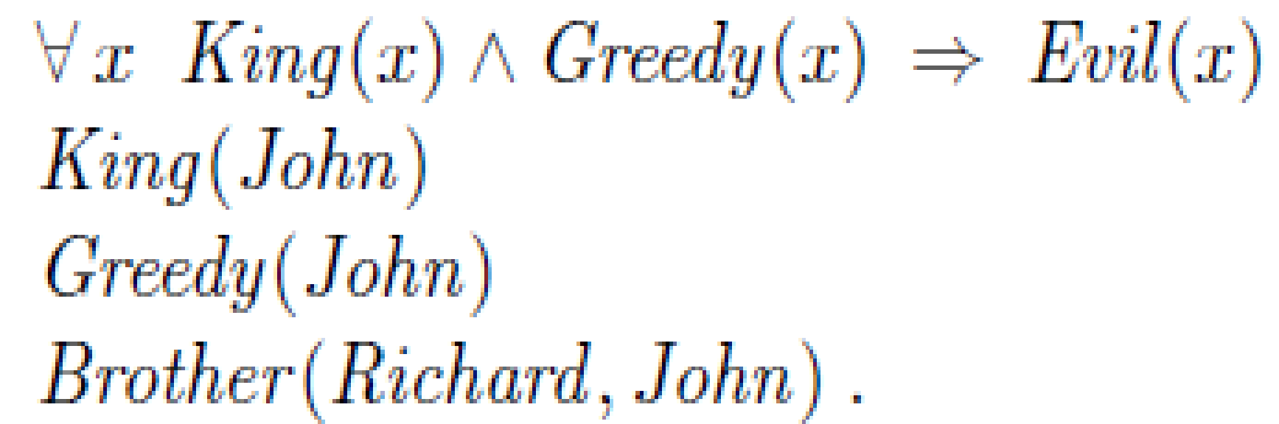
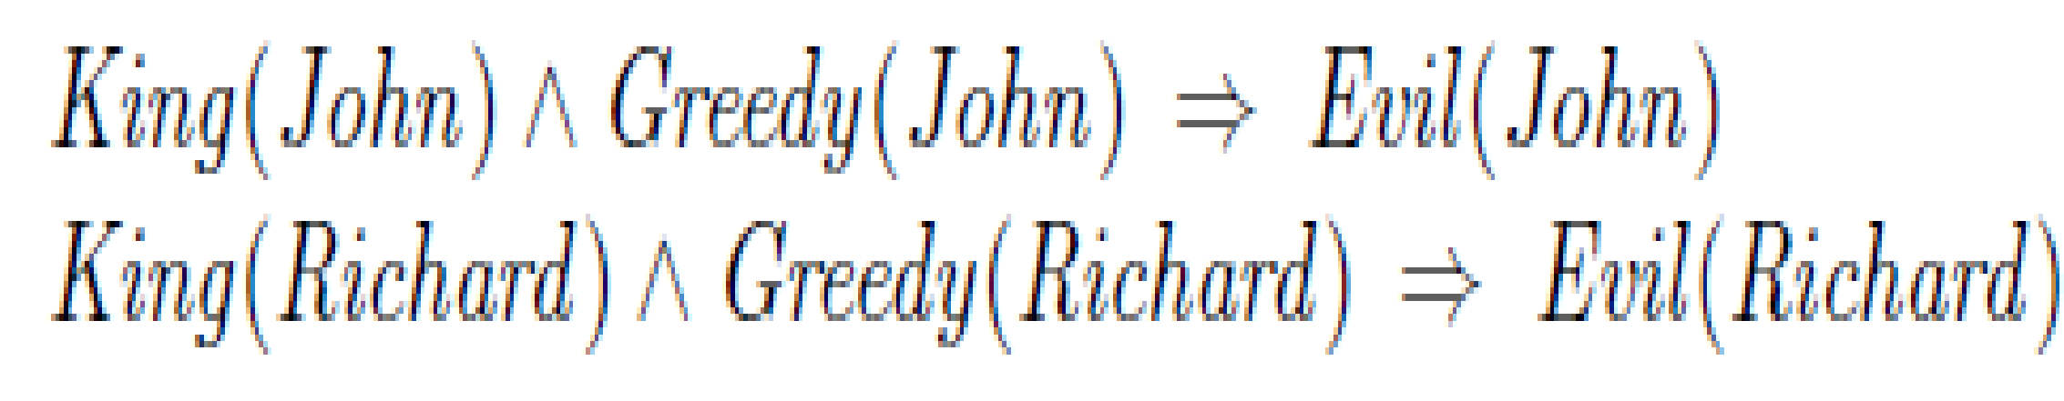
Inferences in FOL
Suppose our KB contains the Sentences.
Apply UI using { x/John } and {X/Richard}
Discard the Universal Quantified Sentence.
If there is a substitutions that satisfies the premises in the KB, then I can add the conclusions into the KB

Slide 73

Inferences – Generalised Modus Ponens
For atomic sentences pi, pi', q, where there is a substitution θ such that SUBST (θ, pi',) = SUBST(θ, pi), for all i
Example:
p1' is king(John) p1 is king(x)
p2' is Greedy(y) p2 is Greedy(x)
θ is {x/John, y/John} q is evil(x)
SUBST(θ,q) is Evil(John)

Slide 74
Syllabus
KNOWLEDGE REPRESENTATION
First order logic – representation revisited – Syntax and semantics for first order logic – Using first order logic – Knowledge engineering in first order logic - Inference in First order logic – propositional versus first order logic – unification and lifting – forward chaining – backward chaining - Resolution - Knowledge representation - Ontological Engineering - Categories and objects

Slide 75
Unification
It is the process of finding substitutions that make different logical expressions look identical.
The UNIFY algorithm takes two sentences and returns a unifier for them if one exists.
UNIFY(p,q)=Θ where SUBST(Θ,p) = SUBST(Θ,q)
If no Unifier exists then the Unification algorithm returns FAILURE.
Example:
p = knows(Richard, x) q = knows(Richard, John)
Θ = {x/John}

Slide 76
Rules for Unification
Predicate symbol must be same, atoms or expressions with different predicate symbols can never be Unified.
Number of arguments in both the expressions must be identical.
Unification will fail if there are two similar variables present in the same expression.

Slide 77
Unification
Example:
p = knows(John, x) q = knows(John, Jane)
p = knows(John, x) q = knows(y, Mary)
p = knows(John, x) q = knows(y, Mother(y))
p = knows(John, x) q = knows(x, Mary)
This problem can be avoided by standardizing apart one of the two sentences being unified (i.e renaming its variables to avoid name clashes)
p=knows(John,x) q= knows(x17, Mary)
Θ = {x/Jane}
Θ = {x/Mary, y/John}
Θ = {y/John, x/Mother(John)}
fail

Slide 78
Unification
One more complication is there can be more than one unifiers.
p = knows(John, x) q = knows(y, z)
The Most General Unifier (MGU) is the general unifier with fewer restrictions on the values of the variables.
Θ = {y/John, x/z} is selected
Θ = {y/John, x/z} or {x/John, y/John, z/John}

Slide 79
Syllabus
KNOWLEDGE REPRESENTATION
First order logic – representation revisited – Syntax and semantics for first order logic – Using first order logic – Knowledge engineering in first order logic - Inference in First order logic – propositional versus first order logic – unification and lifting – forward chaining – backward chaining - Resolution - Knowledge representation - Ontological Engineering - Categories and objects

Slide 80
Forward Chaining
It is a simple algorithm.
It starts from the known facts, it triggers all the rules whose premises are satisfied adding their conclusions to the known facts.
The process repeats until the query is answered or new facts are added.
Known facts → Goal

Slide 81
Forward Chaining - Steps
Represent the facts as first-order definite clauses.
Use Forward Chaining Algorithm

Slide 82
Forward Chaining - First Order Definite Clauses
A definite clause is either atomic or is an implication whose antecedent is a conjunction of positive literals and whose consequent is a single positive literal.
Literal is any predicate applied to a set of terms.
First order literals can include variables and they are assumed to be universally quantified.
Example:
King(John)
Greedy(y)
King(x) ∧ Greedy (x) → Evil (x)

Slide 83
Example - As per the law, it is a crime for an American to sell weapons to hostile nations. Country A, an enemy of America, has some missiles, and all the missiles were sold to it by Robert, who is an American citizen. Prove that "Robert is criminal."
Solution: Step 1 - Identify the facts
It is a crime for an American to sell weapons to hostile nations.
Country A has some missiles.
All of the missiles were sold to country A by Robert.
Missiles are weapons.
Enemy of America is known as hostile.
Country A is an enemy of America.
Robert is American

Slide 84
Example
Step 2 - Conversion of facts into First Order Definite Clauses
It is a crime for an American to sell weapons to hostile nations. (Let's say p, q, and r are variables)
American (p) ∧ weapon(q) ∧ sells (p, q, r) ∧ hostile(r) → Criminal(p) .....(1)
Country A has some missiles.
∃p Owns(A, p) ∧ Missile(p)
It can be written in two definite clauses by using Existential Instantiation, introducing new Constant T1.
Owns(A, T1) ......(2)
Missile(T1) .......(3)

Slide 85
Example
All of the missiles were sold to country A by Robert.
∀p Missiles(p) ∧ Owns (A, p) → Sells (Robert, p, A) or
Missiles(p) ∧ Owns (A, p) → Sells (Robert, p, A) ......(4)
Missiles are weapons.
Missile(p) → Weapons (p) .......(5)
Enemy of America is known as hostile.
Enemy(p, America) →Hostile(p) ........(6)

Slide 86
Example
Country A is an enemy of America.
Enemy (A, America) .........(7)
Robert is American
American(Robert). ..........(8)

Slide 87
Example - Step 2: Conversion of facts into First Order Definite Clauses
American (p) ∧ weapon(q) ∧ sells (p, q, r) ∧ hostile(r) → Criminal(p)
Owns(A, T1)
Missile(T1)
Missiles(p) ∧ Owns (A, p) → Sells (Robert, p, A)
Missile(p) → Weapons (p)
Enemy(p, America) →Hostile(p)
Enemy (A, America)
American(Robert).

Slide 88

Example
Step 3: Use Forward Chaining Algorithm
Step 3.1: Start with known facts and choose the sentences which do not have implications

Slide 89
Example
Step 3.2: Select the facts which infer from available facts and with satisfied premises
Rule-(1) does not satisfy premises, so it will not be added in the first iteration. [American (p) ∧ weapon(q) ∧ sells (p, q, r) ∧ hostile(r) → Criminal(p)]
Rule-(2) and (3) are already added. [Owns(A, T1), Missile(T1)]

Slide 90
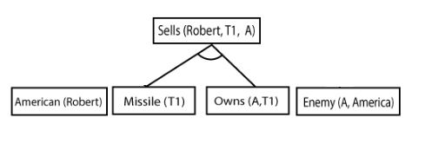
Example
Rule-(4) satisfy with the substitution {p/T1}, so Sells (Robert, T1, A) is added, which infers from the conjunction of Rule (2) and (3).
Missiles(p) ∧ Owns (A, p) → Sells (Robert, p, A)

Slide 91
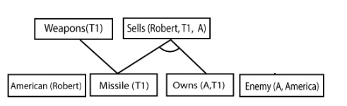
Example
Rule-(5) is satisfied with the substitution(p/T1), and Weapon(T1) is added
Missile(p) → Weapons (p)

Slide 92
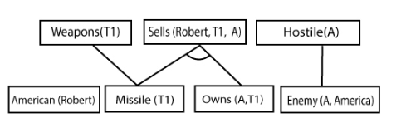
Example
Rule-(6) is satisfied with the substitution(p/A), so Hostile(A) is added
Enemy(p, America) →Hostile(p)
Rule-(7) and Rule(8) are already added
Enemy (A, America), American(Robert)

Slide 93
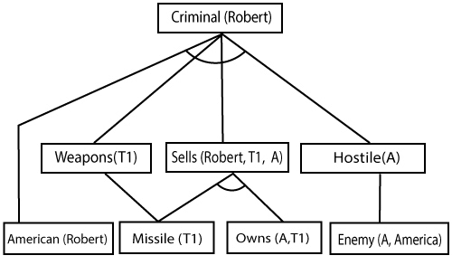
Example
Step 3.3: Rule-(1) is satisfied with the substitution {p/Robert, q/T1, r/A}, Criminal(Robert) can be added, which infers all the available facts
American (p) ∧ weapon(q) ∧ sells (p, q, r) ∧ hostile(r) → Criminal(p)

Slide 94
Syllabus
KNOWLEDGE REPRESENTATION
First order logic – representation revisited – Syntax and semantics for first order logic – Using first order logic – Knowledge engineering in first order logic - Inference in First order logic – propositional versus first order logic – unification and lifting – forward chaining – backward chaining - Resolution - Knowledge representation - Ontological Engineering - Categories and objects

Slide 95
Backward Chaining
It works backward from the goal, chaining through rules to find known facts that support the proof
Goal → known facts
Example: As per the law, it is a crime for an American to sell weapons to hostile nations. Country A, an enemy of America, has some missiles, and all the missiles were sold to it by Robert, who is an American citizen. Prove that "Robert is criminal."

Slide 96
Example - As per the law, it is a crime for an American to sell weapons to hostile nations. Country A, an enemy of America, has some missiles, and all the missiles were sold to it by Robert, who is an American citizen. Prove that "Robert is criminal."
Solution: Step 1 - Identify the facts
It is a crime for an American to sell weapons to hostile nations.
Country A has some missiles.
All of the missiles were sold to country A by Robert.
Missiles are weapons.
Enemy of America is known as hostile.
Country A is an enemy of America.
Robert is American

Slide 97
American (p) ∧ weapon(q) ∧ sells (p, q, r) ∧ hostile(r) → Criminal(p)
Owns(A, T1)
Missile(T1)
Missiles(p) ∧ Owns (A, p) → Sells (Robert, p, A)
Missile(p) → Weapons (p)
Enemy(p, America) →Hostile(p)
Enemy (A, America)
American(Robert).
Criminal(Robert)

Slide 98
American (p) ∧ weapon(q) ∧ sells (p, q, r) ∧ hostile(r) → Criminal(p)
Owns(A, T1)
Missile(T1)
Missiles(p) ∧ Owns (A, p) → Sells (Robert, p, A)
Missile(p) → Weapons (p)
Enemy(p, America) →Hostile(p)
Enemy (A, America)
American(Robert).
Criminal(Robert)
1: { p / Robert }
American(Robert)
Weapon(q)
Sells(Robert,q,r)
Hostile(r)
{ }

Slide 99
American (p) ∧ weapon(q) ∧ sells (p, q, r) ∧ hostile(r) → Criminal(p)
Owns(A, T1)
Missile(T1)
Missiles(p) ∧ Owns (A, p) → Sells (Robert, p, A)
Missile(p) → Weapons (p)
Enemy(p, America) →Hostile(p)
Enemy (A, America)
American(Robert).
Criminal(Robert)
1: { p / Robert }
American(Robert)
Weapon(q)
Sells(Robert,q,r)
Hostile(r)
8: { }

Slide 100
American (p) ∧ weapon(q) ∧ sells (p, q, r) ∧ hostile(r) → Criminal(p)
Owns(A, T1)
Missile(T1)
Missiles(p) ∧ Owns (A, p) → Sells (Robert, p, A)
Missile(p) → Weapons (p)
Enemy(p, America) →Hostile(p)
Enemy (A, America)
American(Robert).
Criminal(West)
Criminal(Robert)
1: { p / Robert }
American(West)
American(Robert)
Sells(West,y,z)
Sells(Robert,q,r)
Hostile(z)
Weapon(y)
Hostile(r)
Weapon(q)
8: { }
5 : { p / q }
Missile(q)

Slide 101
American (p) ∧ weapon(q) ∧ sells (p, q, r) ∧ hostile(r) → Criminal(p)
Owns(A, T1)
Missile(T1)
Missiles(p) ∧ Owns (A, p) → Sells (Robert, p, A)
Missile(p) → Weapons (p)
Enemy(p, America) →Hostile(p)
Enemy (A, America)
American(Robert).
Criminal(West)
Criminal(West)
Criminal(Robert)
1: { p / Robert }
American(West)
American(West)
American(Robert)
Sells(West,M1,z)
Sells(West,y,z)
Sells(Robert,T1,r)
Hostile(z)
Hostile(z)
Weapon(y)
Hostile(r)
Weapon(y)
Weapon(T1)
8: { }
5 :
5 : { p / q }
Missile(M1)
Missile(T1)
3: { q / T1 }

Slide 102
American (p) ∧ weapon(q) ∧ sells (p, q, r) ∧ hostile(r) → Criminal(p)
Owns(A, T1)
Missile(T1)
Missiles(p) ∧ Owns (A, p) → Sells (Robert, p, A)
Missile(p) → Weapons (p)
Enemy(p, America) →Hostile(p)
Enemy (A, America)
American(Robert).
Criminal(West)
Criminal(West)
Criminal(West)
Criminal(Robert)
1: { p / Robert }
American(West)
American(West)
American(West)
American(Robert)
Sells(West,M1,z)
Sells(West,M1,z)
Sells(West,y,z)
Hostile(z)
Hostile(z)
Hostile(z)
Weapon(y)
Sells(Robert,T1,A)
Hostile(A)
Weapon(y)
Weapon(y)
Weapon(T1)
8: { }
5 :
5 :
5 : { p / q }
Missile(M1)
4 : { p / T1}
{ r / A }
Missile(M1)
Missile(T1)
3: { q / T1 }
Missile(T1)
Owns(A,T1)

Slide 103
American (p) ∧ weapon(q) ∧ sells (p, q, r) ∧ hostile(r) → Criminal(p)
Owns(A, T1)
Missile(T1)
Missiles(p) ∧ Owns (A, p) → Sells (Robert, p, A)
Missile(p) → Weapons (p)
Enemy(p, America) →Hostile(p)
Enemy (A, America)
American(Robert).
Criminal(West)
Criminal(West)
Criminal(West)
Criminal(West)
Criminal(Robert)
1: { p / Robert }
American(West)
American(West)
American(West)
American(West)
American(Robert)
Sells(West,M1,z)
Sells(West,M1,z)
Sells(West,M1,z)
Sells(West,y,z)
Hostile(Nono)
Hostile(z)
Hostile(z)
Hostile(z)
Weapon(y)
Sells(Robert,T1,A)
Hostile(A)
Weapon(y)
Weapon(y)
Weapon(y)
Weapon(q)
8: { }
5 :
5 :
5 :
5 : { p / q }
Missile(M1)
4 : { p / T1}
{ r / A }
Missile(M1)
Missile(M1)
Missile(T1)
3: { q / T1 }
Missile(M1)
Missile(T1)
Owns(Nano,M1)
Owns(A,T1)
3 : { }
2 : { }

Slide 104
American (p) ∧ weapon(q) ∧ sells (p, q, r) ∧ hostile(r) → Criminal(p)
Owns(A, T1)
Missile(T1)
Missiles(p) ∧ Owns (A, p) → Sells (Robert, p, A)
Missile(p) → Weapons (p)
Enemy(p, America) →Hostile(p)
Enemy (A, America)
American(Robert).
Criminal(West)
Criminal(West)
Criminal(West)
Criminal(West)
Criminal(West)
Criminal(Robert)
1: { p / Robert }
American(West)
American(West)
American(West)
American(West)
American(West)
American(Robert)
Sells(West,M1,z)
Sells(West,M1,z)
Sells(West,M1,z)
Sells(West,M1,z)
Sells(West,y,z)
Hostile(Nono)
Hostile(Nono)
Hostile(z)
Hostile(z)
Hostile(z)
Weapon(y)
Sells(Robert,T1,A)
Hostile(A)
Weapon(y)
Weapon(y)
Weapon(y)
Weapon(y)
Weapon(q)
8: { }
5 :
5 :
5 :
5 :
5 : { p / q }
6 : { p / A}
Missile(M1)
Missile(M1)
Missile(M1)
Missile(M1)
Missile(T1)
4 : { p / T1}
{ r / A }
Enemy(A, America)
3: { q / T1 }
Missile(M1)
Missile(M1)
Missile(T1)
Owns(Nano,M1)
Owns(Nano,M1)
Owns(A,T1)
3 : { }
3 : { }
2 : { }
2 : { }

Slide 105
American (p) ∧ weapon(q) ∧ sells (p, q, r) ∧ hostile(r) → Criminal(p)
Owns(A, T1)
Missile(T1)
Missiles(p) ∧ Owns (A, p) → Sells (Robert, p, A)
Missile(p) → Weapons (p)
Enemy(p, America) →Hostile(p)
Enemy (A, America)
American(Robert).
Criminal(West)
Criminal(West)
Criminal(West)
Criminal(West)
Criminal(West)
Criminal(Robert)
1: { p / Robert }
American(West)
American(West)
American(West)
American(West)
American(West)
American(Robert)
Sells(West,M1,z)
Sells(West,M1,z)
Sells(West,M1,z)
Sells(West,M1,z)
Sells(West,y,z)
Hostile(Nono)
Hostile(Nono)
Hostile(z)
Hostile(z)
Hostile(z)
Weapon(y)
Sells(Robert,T1,A)
Hostile(A)
Weapon(y)
Weapon(y)
Weapon(y)
Weapon(y)
Weapon(q)
8: { }
5 :
5 :
5 :
5 :
5 : { p / q }
6 : { p / A}
Missile(M1)
Missile(M1)
Missile(M1)
Missile(M1)
Missile(T1)
4 : { p / T1}
{ r / A }
Enemy(A, America)
3: { q / T1 }
7: { }
Missile(M1)
Missile(M1)
Missile(T1)
Owns(Nano,M1)
Owns(Nano,M1)
Owns(A,T1)
3 : { }
3 : { }
2 : { }
2 : { }

Slide 106
Resolution
It proves by Contradiction
The sentences must be Conjunctive Normal Form
It is a single inference rule, that yields a complete inference algorithm.
Resolution can resolve two clauses if they contain complementary literals, which are assumed to be standardized apart so that they share no variables.

Slide 107
Steps For Resolution
Conversion of facts into FOL
Convert FOL to CNF
Eliminate all implication (→) and rewrite
Move negation (¬)inwards and rewrite
Negate the Statement to be Proved
Draw Resolution Graph

Slide 108
Resolution - Example
As per the law, it is a crime for an American to sell weapons to hostile nations. Country A, an enemy of America, has some missiles, and all the missiles were sold to it by Robert, who is an American citizen. Prove that "Robert is criminal."
Step 1 - Conversion of facts into FOL
American (p) ∧ weapon(q) ∧ sells (p, q, r) ∧ hostile(r) → Criminal(p)
Owns(A, T1)
Missile(T1)
Missiles(p) ∧ Owns (A, p) → Sells (Robert, p, A)
Missile(p) → Weapons (p)
Enemy(p, America) →Hostile(p)
Enemy (A, America)
American(Robert).

Slide 109
Resolution - Example
Step 2 - Convert FOL to CNF
American (p) ∧ weapon(q) ∧ sells (p, q, r) ∧ hostile(r) → Criminal(p)
¬[American (p) ∧ weapon(q) ∧ sells (p, q, r) ∧ hostile(r)] ∨ Criminal(p)
¬American (p) ∨ ¬weapon(q) ∨ ¬sells (p, q, r) ∨ ¬hostile(r) ∨ Criminal(p)
2. Owns(A, T1)
3. Missile(T1)

Slide 110
Resolution - Example
Step 2 - Convert FOL to CNF
4. Missile(p) ∧ Owns (A, p) → Sells (Robert, p, A)
¬ [Missile(p) ∧ Owns (A, p)] ∨ Sells (Robert, p, A)
¬ Missile(p) ∨ ¬ Owns (A, p) ∨ Sells (Robert, p, A)
5. Missile(p) → Weapons (p)
¬ Missile(p) ∨ Weapons (p)

Slide 111
Resolution - Example
Step 2 - Convert FOL to CNF
6. Enemy(p, America) →Hostile(p)
¬Enemy(p, America) ∨ Hostile(p)
7. Enemy (A, America)
8. American(Robert).

Slide 112
Resolution - Example
Step 3 - Negate the Statement to be Proved
¬Criminal (Robert)

Slide 113
Resolution - Example
Step 4 – Draw the Resolution Graph
¬American (p) ∨ ¬weapon(q) ∨ ¬sells (p, q, r) ∨ ¬hostile(r) ∨ Criminal(p)
Owns(A, T1)
Missile(T1)
¬ Missile(p) ∨ ¬ Owns (A, p) ∨ Sells (Robert, p, A)
¬ Missile(p) ∨ Weapons (p)
¬Enemy(p, America) ∨ Hostile(p)
Enemy (A, America)
American(Robert)

Slide 114
Resolution - Example
Step 4 - Resolution Proof
¬American (p) ∨ ¬weapon(q) ∨ ¬sells (p, q, r) ∨ ¬hostile(r) ∨ Criminal(p)
¬Criminal (Robert)
1: Θ = {p/Robert}
American (Robert)
¬American (Robert) ∨ ¬weapon(q) ∨ ¬sells (Robert, q, r) ∨ ¬hostile(r)
8: Θ = { }
¬ Missile(p) ∨ Weapon (p)
¬Weapon(q) ∨ ¬sells (Robert, q, r) ∨ ¬hostile(r)
5: Θ = { p/q }
¬ Missile(p) ∨ ¬sells (Robert, q, r) ∨ ¬hostile(r)

Slide 115
Resolution - Example
Step 4 - Resolution Proof
¬American (p) ∨ ¬weapon(q) ∨ ¬sells (p, q, r) ∨ ¬hostile(r) ∨ Criminal(p)
¬Criminal (Robert)
1: Θ = {p/Robert}
American (Robert)
¬American (Robert) ∨ ¬weapon(q) ∨ ¬sells (Robert, q, r) ∨ ¬hostile(r)
8: Θ = { }
¬ Missile(p) ∨ Weapon (p)
¬Weapon(q) ∨ ¬sells (Robert, q, r) ∨ ¬hostile(r)
5: Θ = { p/q }
Missile(T1)
¬ Missile(q) ∨ ¬sells (Robert, q, r) ∨ ¬hostile(r)
3: Θ = { q/T1 }
¬ Missiles(p) ∨ ¬ Owns (A, p) ∨ Sells (Robert, p, A)
¬sells (Robert, T1, r) ∨ ¬hostile(r)

Slide 116
¬ Missiles(p) ∨ ¬ Owns (A, p) ∨ Sells (Robert, p, A)
¬sells (Robert, T1, r) ∨ ¬hostile(r)
4: Θ = { p/T1, r/A }
Missile(T1)
¬ Missiles(T1) ∨ ¬ Owns (A, T1) ∨ ¬hostile(A)
3: Θ = { }
Owns(A, T1)
¬ Owns (A, T1) ∨ ¬hostile(A)
2: Θ = { }
¬Enemy(p, America) ∨ Hostile(p)
¬hostile(A)
6: Θ = {p/A }
Enemy(A, America)
¬Enemy(A, America)
7: Θ = { }

Slide 117
Syllabus
KNOWLEDGE REPRESENTATION
First order logic – representation revisited – Syntax and semantics for first order logic – Using first order logic – Knowledge engineering in first order logic - Inference in First order logic – propositional versus first order logic – unification and lifting – forward chaining – backward chaining - Resolution - Knowledge representation - Ontological Engineering - Categories and objects

Slide 118
Knowledge representation - Ontological Engineering
Representing the general concepts like Events, Time, Physical objects, Belief are called Ontological Engineering.
The need of ontological engineering is to give the Overall Idea of the Domain using the abstract concept.
This helps the agent to learn about the environment and reason about each and every actions.
The main objective is to create the more generic and the flexible representation.

Slide 119
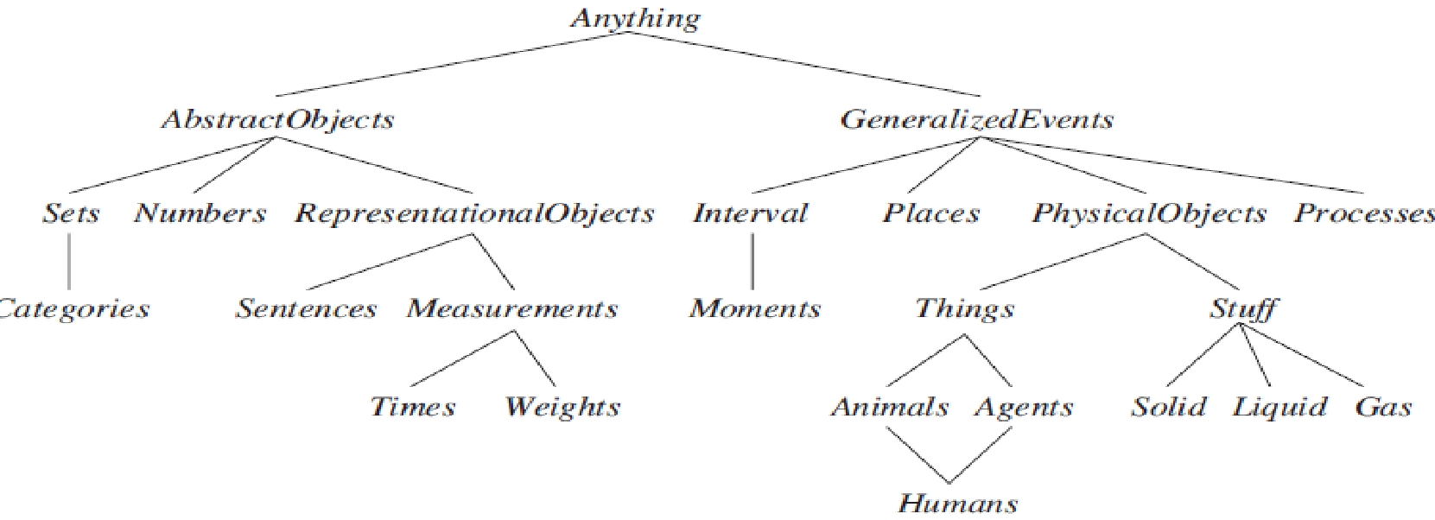
Ontological Engineering – General Framework
The general framework of concepts is called Upper Ontology
The generic concepts are at the Top and the more specific concepts are at the Bottom.
Upper ontology of the World

Slide 120
General Purpose Ontologies - Characteristics
The general purpose ontologies should be applicable in more or less to any specific domain and the user can define the additional axioms.
All the general item must be unified that can help the agent for reasoning and problem solving.

Slide 121
Categories and Objects
The organisations of objects into categories is a important part of Knowledge Representation.
Reasoning happens at the level of categories.
Categories play a important role in prediction.
There are two choices for representing categories in FOL
Predicates
Objects

Slide 122
Categories and Objects
Categories organise and simplify the KB through Inheritance.
Example: All Foods are edible
Fruit is a subclass of food
Apple is a subclass of Fruit
Inference:Apple is edible

Slide 123
Categories and Objects
Some facts types are listed below:
An object is a member of category.
Apple ∈ Fruit
A category is a subclass of another category.
Fruit ⊂ Food
All members of a category have some properties
(x ∈ Apple) ⇒ Red(x)
Members of a category can be recognized by some properties
Orange(x) ∧ Round(x) ∧ Diameter(x)=9.5’’ ∧ x ∈ Balls ⇒ x ∈ Basketballs

Slide 124
Categories and Objects
A category as a whole has some properties
Dogs ∈ Domesticatedspecies
Disjoint Relation: Two or more categories are disjoint if they have no members in Common.
Disjoint({Animals, Vegetables})

Slide 125
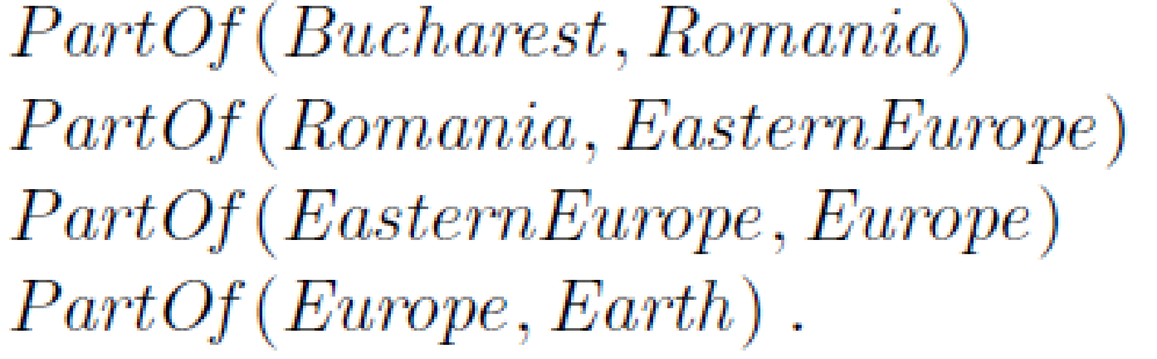
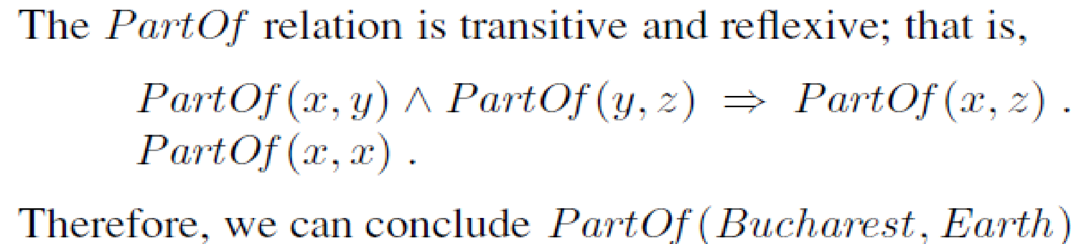
Categories and Objects - Physical Composition
One object can be part of another object - Partof Relation.
Example:

Slide 126
Categories and Objects - Measurements
Some Objects have properties such as height, mass, cost etc.
The values that we assign for these properties are called the measures.
Example: length of a line segment
It is represented by a units function which takes number as arguments:
Conversion between units is done by equating multiples of one unit with another
d ∈ Days -> Duration(d) ⇒ Hours(24)

